Slide 1
Exercises for Personal and Team Development
Part 11: Relationship Management

Slide 2
Roadmap
Exercise 1:
Practice Building Trust with Stakeholders
Exercise 2:
Develop Challenging Capabilities
Exercise 3:
Assess Virtual Team Effectiveness
Key Takeaways
Introduction

Slide 3
Twelve Competencies for High Performance in IT
1. Communication
2. Decision Making
3. Influence
4. Learning Agility
5. Creativity
6. Analytic Ability
Conveys information to diverse audiences, orally and in writing, in a way that is easily understood and actionable.
Considers the relative costs and benefits of potential actions to choose the most appropriate one
Asserts ideas and persuades others to gain support across a matrixed organization
Rapidly acquires new knowledge and learns new skills; deals effectively with ambiguity by using past experience
Applies original thinking to produce new ideas or products; questions assumptions and imagines future possibilities
Can work with data to identify patterns; uses judgment to form conclusions that may challenge conventional wisdom
7. Business Results Orientation
8. Organizational
Awareness
9. Prioritization
10. Process Orientation
11. Relationship
Management
12. Teamwork
Understands business needs; delivers efficient and high-quality results
Understands and works in line with the organization’s mission, values, operations, structure, and goals
Self-directs work through goal setting, time management, and planning
Follows directions; designs practices, processes, procedures, and systems to
simplify work and use resources efficiently
Creates relationships and builds trust with internal and external stakeholders quickly
Promotes
and facilitates
coordination and cooperation among peers
Source: Gartner (April 2019)

Slide 4
Why Relationship Management?
A Crucial Competency Gap
Percentage of IT Employees Who Are at Least at the Proficient Level
More Than 70%
61% to 70%
51% to 60%
Equal or Less Than 50%
Organizational Awareness | 76%
Analytic Ability | 75%
Process Orientation | 71%
Teamwork | 67%
Prioritization | 67%
Business Results Orientation | 64%
Creativity | 58%
Learning Agility | 57%
Communication | 57%
Decision Making | 55%
Relationship Management | 50%
Influence | 46%
n = 2,957
Source: 2013-2015 Gartner IT Talent Assessment.
ª “Proficient” is defined as scoring a 3 on the competency on a 5-point scale. Employees are defined as “at least” proficient if they score a 3, 4, or 5.

Slide 5
Roadmap
Exercise 1:
Practice Building Trust with Stakeholders
Exercise 2:
Develop Challenging Capabilities
Exercise 3:
Assess Virtual Team Effectiveness
Key Takeaways
Introduction

Slide 6
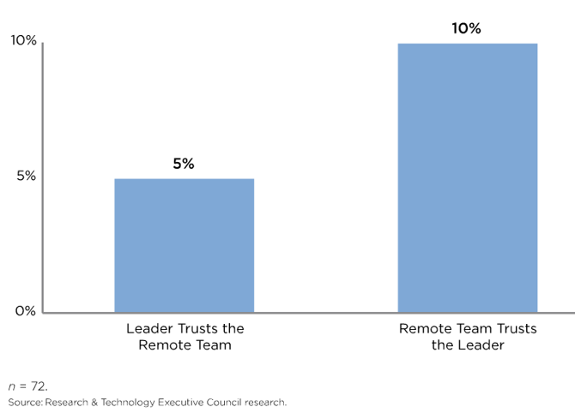
Why Build Trusting Relationships?
Percentage Impact on Remote Team Effectiveness
By Directionality of Trust
Teams which trust their leaders engage in more two-way learning and take on harder projects
Leaders who trust their teams will migrate more challenging projects which match team potential

Slide 7
Exercises to Build Relationship Management Skills
Practice Building Trust with Stakeholders
Identify the drivers behind trusting relationships
Plan action items to build better trust with stakeholders
Develop Challenging Capabilities
Assess Virtual Team Effectiveness

Slide 8
Exercise 1: Practice Building Trust with Stakeholders
Audience for this Exercise
Individual Exercise
When to Use
Building strong relationships with stakeholders
Identifying potential roadblocks towards increasing trust
What this Exercise Teaches
This exercise helps employees understand their relationships with important stakeholders and plan for how to improve them.
Pre-work or Planning Required
Does not require pre-work or planning
Source: Gartner (April 2019)

Slide 9

Exercise 1: Practice Building Trust with Stakeholders
Who Are Your Stakeholders?
Think of a core stakeholder who you would like to improve trust with

Slide 10
Exercise 1: Practice Building Trust with Stakeholders
Identifying Trust Drivers
Trust Driver
Trust Inhibiting Behavior
Read the following lists. Trust drivers are actions and mindsets which enhance trusts, while trust inhibitors are those which hurt trust.
Openness to new ideas
Being immediately dismissive
Friendliness in the office
Personal rivalries
Collaborative mindset
Unwilling to work in teams
Being transparent
Unwilling to share
Encouraging experimentation
Overly dogmatic
Supports you to stakeholders
Detracts from stakeholder support

Slide 11
Exercise 1: Practice Building Trust with Stakeholders
Understanding Important Relationships
Sample behaviors that drive trust
Sample behaviors that inhibit openness
to new ideas
Not seriously considering alternatives
Showing anger over divergent opinions
Not clarifying premature assumptions
1. Be open to new ideas.
Identify the stakeholder’s trust drivers, and the behaviors which might undermine trust between you.
Be transparent.
Encourage open discussions.
Entertain contrarian views
Give freedom to explore and experiment.
Stakeholder
Trust Driver
Trust Inhibiting Behavior
1a.
1.
1b.
2a.
2.
2b.

Slide 12

Exercise 1: Practice Building Trust with Stakeholders
Defining Next Steps
Choose Two Next Steps
 | Meet Face-to-Face Seeing colleagues in person helps you preemptively address communication barriers and develop more accurate impressions of your colleagues’ trustworthiness. Work with your manager to identify opportunities to meet your virtual peers, either through video conferencing or travel arrangements.
 | Make Sure Your Actions Are Transparent Gather your virtual peers’ input on decisions you make that impact them and disseminate information to them to keep them informed.
 | Be Accessible and Responsive Reply to your virtual peers’ communications in a timely manner. Frequently delaying your responses can unintentionally make you appear inaccessible and unresponsive. Further demonstrate your accessibility by sharing non-work related information on occasion, which comes much more naturally among teams in the same office.
 | Maintain Confidentiality of Team Operations Work with your colleagues to surface differing assumptions and to agree on norms for what information can be shared outside of the team.
 | Be Proactive in Assessing Team Progress Identify potential challenges or delays to projects and work with your peers or manager to resolve them.
 | Review Your Own Performance Informally solicit your virtual peers’ feedback on your performance, strengths, development areas, and / or suggestions for improvements. Do this early on to evaluate what you may need to change to be more transparent, accessible, responsive, or proactive with your virtual peers.
 | Share Positive Feedback Do not hesitate to compliment your virtual peers directly or to the whole group when they meaningfully help you with a key task or problem. This helps motivate and engage peers.
Stakeholder

Slide 13
Roadmap
Exercise 1:
Practice Building Trust with Stakeholders
Exercise 2:
Develop Challenging Capabilities
Exercise 3:
Assess Virtual Team Effectiveness
Key Takeaways
Introduction

Slide 14
The Challenger Relationship
Three Most Common Profiles of Employees
Challengers are doubly likely to be successful in high complexity environments compared to the average employee. The other profiles are more likely to underperform.
The Challenger
The Relationship Builder
The Hard Worker
Always has a different view of the world
Understands the customer’s business
Loves to debate
Pushes the customer
Builds strong advocates in customer organization
Generous in giving time to help others
Gets along with everyone
Always willing to go the extra mile
Doesn’t give up easily
Self-motivated
Interested in feedback and development

Slide 15
Exercises to Build Relationship Management Skills
Practice Building Trust with Stakeholders
Develop Challenging Capabilities
Identify the value drivers which motivate our coworkers and clients
Argue constructively in order to build challenger relationships
Assess Virtual Team Effectiveness

Slide 16
Exercise 2: Develop Challenging Capabilities
Audience for this Exercise
Team Exercise (Groups of 2 – 4)
When to Use
While working in teams
Particularly helpful long-term collaboration
What this Exercise Teaches
This exercise teaches employees how to develop ‘challenger relationships’ – connections which use constructive tension to add value – which are the key to building trust and confidence.
Pre-work or Planning Required
Does not require pre-work or planning

Slide 17
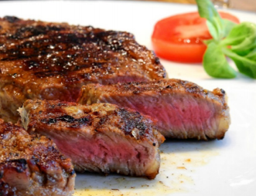

Exercise 2: Develop Challenging Capabilities
Preparing to Teach
Imagine you need to convince a meat-loving friend to eat a few vegetarian meals a week. Spend five minutes brainstorming how the conversation might go.
What assumptions or objections might the person you are trying to convince bring to the table?
What are some of the key points you can teach about the benefits of the vegetarian meal?

Slide 18
Exercise 2: Develop Challenging Capabilities
Asserting Control
Challengers pre-emptively identify the type of arguments made by their stakeholder partners and tailor their responses. Challenger relationships require that we know our partner’s values and assert control by proposing arguments which resonate with them.
Pair the value drivers below with the arguments which address those drivers.
Value Drivers
Arguments (Scrambled)
Health Concerns
You can make vegetarian versions of meat-based staples
Too Expensive
Legumes and Lentils are high in proteins and low in fats
Traditionalism
Cooking vegetarian at home is often cheaper than meat
E.g. Taste and Experience
E.g. Many cuisines, such as Mediterranean and Indian, offer dishes which are both vegetarian and delicious

Slide 19
Exercise 2: Develop Challenging Capabilities
Tailoring for Relevance
Apply the last exercise to an upcoming meeting with a stakeholder. Map out the possible positions that they might come to the table with, the value drivers behind them, and appropriate responses to assert control.
Potential Stakeholder Objection
Value Driver
Argument
E.g. We’ve never done anything like this before
E.g. Inaction puts our culture of innovation and competitive advantage at risk
E.g. Fear of change and risk

Slide 20
Roadmap
Exercise 1:
Practice Building Trust with Stakeholders
Exercise 2:
Develop Challenging Capabilities
Exercise 3:
Assess Virtual Team Effectiveness
Key Takeaways
Introduction

Slide 21
Exercises to Build Relationship Management Skills
Practice Building Trust with Stakeholders
Creating Challenging Relationships
Assess Virtual Team Effectiveness
Evaluate areas of strength and weakness in remote teams
Plan next steps to address areas of difficulty

Slide 22
Exercise 3: Assess Virtual Team Effectiveness
Audience for this Exercise
Team Exercise
When to Use
When working in virtual teams
Especially when unsure or uneasy about team performance
What this Exercise Teaches
This exercise lets managers evaluate their virtual teams and plan next steps to address areas of weakness.
Pre-work or Planning Required
Does not require pre-work or planning
Source: Gartner (April 2019)

Slide 23
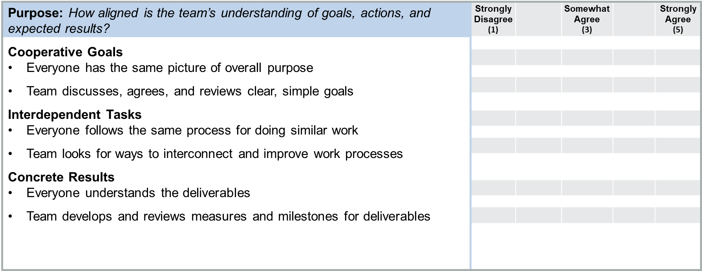

Exercise 3: Assess Virtual Team Effectiveness
Team Effectiveness Survey Setup
Virtual teams struggle with evaluation, because reviews focus on the tools that the team uses rather than relationships between the team and the manager.
Ask members of your virtual team to fill out the following survey. Tally up scores by the section that they are boxed into and average them between team members to gauge which areas your virtual team struggles in.
Sections with an average score under 18 should be the first targets for improvement.
Have members of a virtual team rate each bullet point on a scale of 1 to 5 based on level of agreement

Slide 24
Exercise 3: Assess Virtual Team Effectiveness
Team Effectiveness Survey – Part 1: Purpose
To what extent do you disagree or agree with the following statements about your virtual team?
Strongly Disagree (1) |  | Somewhat Agree (3) |  | Strongly Agree (5)
Purpose: How aligned is the team’s understanding of goals, actions, and
expected results?
Cooperative Goals
Everyone has the same picture of overall purpose
Team discusses, agrees, and reviews clear, simple goals
Interdependent Tasks
Everyone follows the same process for doing similar work
Team looks for ways to interconnect and improve work processes
Concrete Results
Everyone understands the deliverables
Team develops and reviews measures and milestones for deliverables

Slide 25
Exercise 3: Assess Virtual Team Effectiveness
Team Effectiveness Survey – Part 2: Links
To what extent do you disagree or agree with the following statements about your virtual team?
Links: How comfortable is the team with communicating internally
Multiple Media
A variety of media is available and accessible
Team uses collaboration tools consistently and creatively
Boundary-Crossing Interactions
Team has collaboratively established operating agreements that are
actively applied
Team actively implements strategy for engagement across
organization boundaries
Trusting Relationships
Team has high level of trust
Team members build “social capital” through multiple connections
Strongly Disagree (1) |  | Somewhat Agree (3) |  | Strongly Agree (5)

Slide 26
Exercise 3: Assess Virtual Team Effectiveness
Team Effectiveness Survey – Part 3: People
To what extent do you disagree or agree with the following statements about your virtual team?
Strongly Disagree (1) |  | Somewhat Agree (3) |  | Strongly Agree (5)
People: How familiar is the team with roles and responsibilities?
Independent Members
People have the freedom and flexibility to do their work
The team continuously clarifies roles, responsibilities and competencies
needed
Shared Leadership
Leadership is widely distributed and shifts as needed
Individuals are encouraged to lead and to follow as appropriate
Integrated Levels
Key system interdependencies are clearly articulated
(looking up, down and across boundaries)
People are encouraged to talk across levels

Slide 27
Exercise 3: Assess Virtual Team Effectiveness
Team Effectiveness Survey – Part 4: Time
To what extent do you disagree or agree with the following statements about your virtual team?
Strongly Disagree (1) |  | Somewhat Agree (3) |  | Strongly Agree (5)
Time: How clear are project timelines and milestones?
Common Calendar
Team has clear milestones and schedules of dates
People are aware of ongoing key team dates and cultural calendar
Interrelated Projects
Task timelines are collaboratively established
Team is able to adapt to rapidly changing conditions
Awareness of Phase
Team has clear view of its lifecycle and current phase
People discuss team processes and suggestions for improvements

Slide 28
Exercise 3: Assess Virtual Team Effectiveness
Making Meetings More Effective
This tool allows you to change virtual meetings to address areas of weakness. First, average the team members’ scores for each section. Based on which sections score lowest, view the areas for improvement.
Section Scores
Areas for Improvement
Set clear goals and agendas pre-meeting and listing action items at the end of meetings
Purpose:
Links:
People:
Time:
Flip to the next pages for tangible action items to improve your virtual team.
Work on communication during meetings, and use effective electronic communication between meetings
Concentrate on pre-meeting management, and growing participation during meetings
Clearly state responsibilities at the end of meetings, and keep members aware of each others’ work between meetings.

Slide 29
Exercise 3: Assess Virtual Team Effectiveness
Take Action: Purpose and Links
These action items are next-steps for addressing areas from the survey with low average scores.
Action Items
Pre-meeting
Circulate a clear agenda with time allocations
Post draft documents in a central location and have all team embers comment on them. At the meeting, only discuss areas of disagreement
End Of Meeting
List Out action items, such as task assignments and due dates; post them in a central location
Identify who will take notes at the next team meeting
For low scores in ‘Purpose’
During the Meeting
Call on and obtain everyone's input; do not rely solely on colleagues who volunteer information
Make the meeting engaging through the use of interactive technology. including instant-messaging and real-time polling tools
Have a team member take notes to send out after the meeting
Between Meetings
Use electronic communications to share both formal and informal news with the team
Use automatic notifications of postings to a shared team website to keep members up-to-date on progress
For low scores in ‘Links’

Slide 30
Exercise 3: Assess Virtual Team Effectiveness
Take Action: People and Time
These action items are next-steps for addressing areas from the survey with low average scores.
Action Items
Pre-meeting
Circulate a clear agenda with time allocations
Post draft documents in a central location and have all team embers comment on them. At the meeting, only discuss areas of disagreement
During the Meeting
Call on and obtain everyone's input; do not rely solely on colleagues who volunteer information
Make the meeting engaging through the use of interactive technology. including instant-messaging and real-time polling tools
Have a team member take notes to send out after the meeting
For low scores in ‘People’
End Of Meeting
List Out action items, such as task assignments and due dates; post them in a central location
Identify who will take notes at the next team meeting
Between Meetings
Use electronic communications to share both formal and informal news with the team
Use automatic notifications of postings to a shared team website to keep members up-to-date on progress
For low scores in ‘Time’

Slide 31
Roadmap
Exercise 1:
Practice Building Trust with Stakeholders
Exercise 2:
Developing Challenging Capabilities
Exercise 3:
Assess Virtual Team Effectiveness
Key Takeaways
Introduction

Slide 32
Key Takeaways
Proactively identify and address the drivers of, and roadblocks to, trust with stakeholders.
Build challenger relationships; instead of focusing solely on solving problems, be willing to contribute and push your partners.
Assess teams by their competencies and outcomes, not their tools.
Increase the effectiveness of teams by targeting the specific causes of failure. Is the problem with people, links, time, or purpose?

